Slide 1

SPC-3DGS
3D SCENE RECONSTRUCTION WITH SINGLE PHOTON CAMERAS & GAUSSIAN SPLATTING
EE21B144: Sujal Burad
MM21B044: Nikshay Jain
EE5176: COMPUTATIONAL PHOTOGRAPHY

Slide 2


Problems
Conventional RGB & neural methods fail with blur, low-light, and noise
1
SPAD/SPC detect photons directly at high speeds, but with noisy/binary output.
2
3D scene reconstruction becomes challenging in conditions like motion blur, low-light, etc.
3
Reproduce PhotonSplat baseline using SPC binary frames and binary cross-entropy loss.
1
Tasks
Develop trajectory-aware accumulation (blur modeling, exposure loss functions), inspired by BAD-Gaussians
2

Slide 3
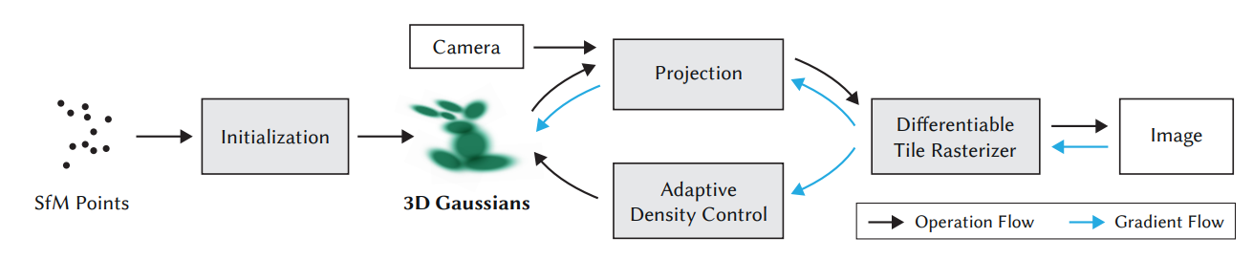
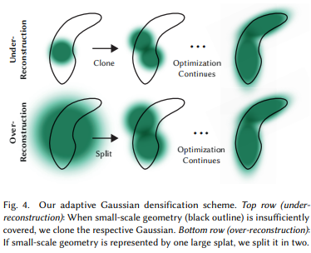
3D Gaussian Splatting (SIGGRAPH 2023)
Millions of 3D Gaussians—explicit, differentiable, adaptive.
Dynamic density control: clone, split, prune for detail.
Fast GPU rasterization: Real-time, high-quality results.
Benchmark results: Outperforming NeRF in quality & speed.
5
Notes:
3D Gaussian Splatting revolutionized radiance field rendering, enabling explicit scene modeling with real-time rendering by adaptive management of millions of Gaussians, vastly outperforming previous neural field methods in speed and quality.

Slide 4
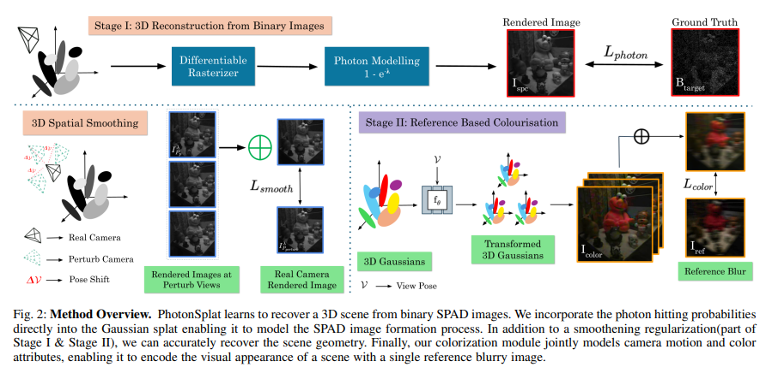
PhotonSplat (ICCP 2025)
Direct modeling of photon arrivals with binary cross-entropy loss.
3D Gaussian Splat representation for scene geometry.
Spatial consistency regularization: reduces overfit to noisy input.
Colorization: recovers color even from blurry ref images.
5
Notes:
PhotonSplat models the physical arrival of photons, directly supports binary SPAD data, and introduces view-consistency regularization—making it much more robust against noise. Also, it offers innovative colorization using just a single blurry reference

Slide 5
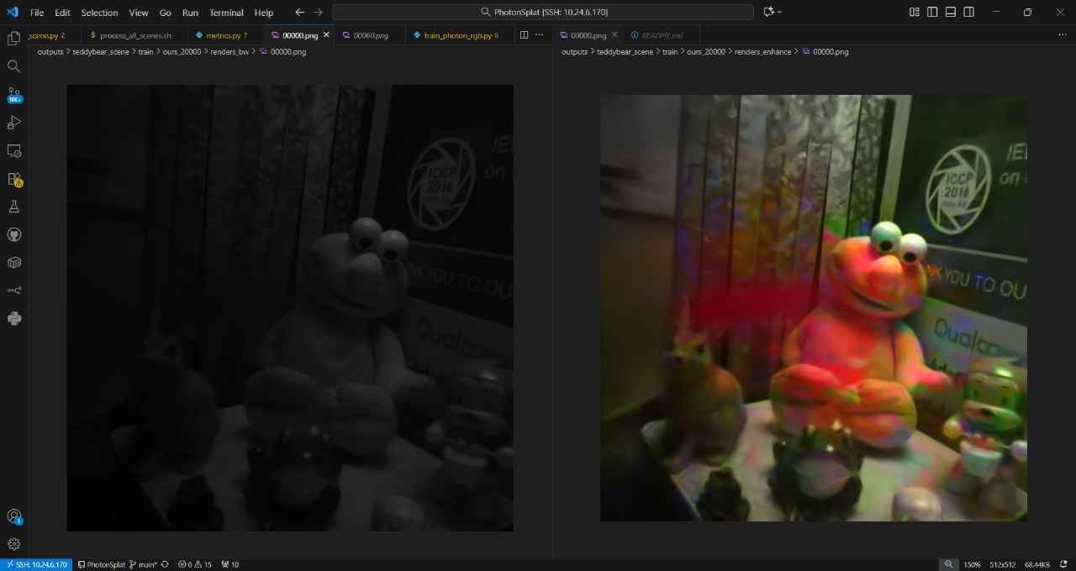
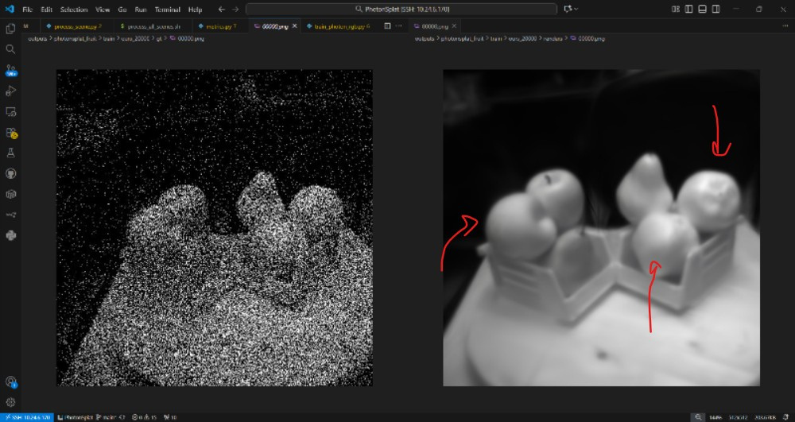

black/white input
reference based colorization
Results:
Task 1
[ITER 20000] NUM GAUSSIAN: 3019
[ITER 20000] Evaluating train:
L1: 0.013672358170151711
PSNR: 33.595664978027344
SSIM: 0.8952
LPIPS: 0.2492
Photonsplat results on validation set, iteration 20k
input binary frame of photonsplat dataset
reconstructed render using the phtonsplat, somewhat blurred
Notes:
Blurring is taken care of in task2 where photon trajectory is accumulated along SPC frames to make robust reconstruction, using bad gaussian

Slide 6
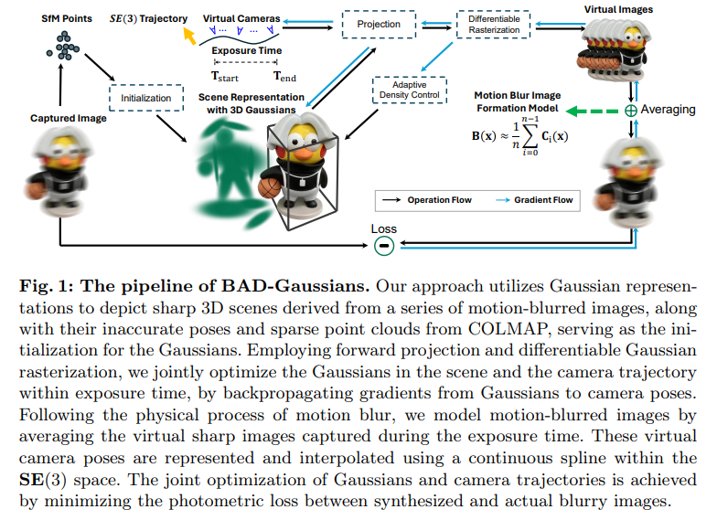
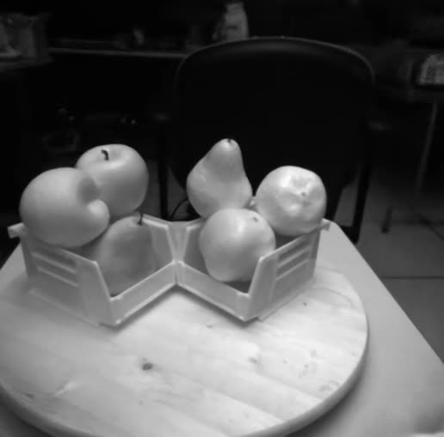
BAD-Gaussians (ECCV 2024)
Physically-accurate blur simulation: average virtual sharp images along camera motion.
Joint optimization: Gaussian scene & exposure-time camera trajectory.
Bundle adjustment: handles severe blur, poor COLMAP pose.
Fast, robust: Real-time rendering even with blurred input.
Fruits
5
Notes:
BAD-Gaussians takes Gaussian Splatting further—it physically models the motion blur from camera movement, then jointly optimizes both the scene and camera motion trajectory. This makes it uniquely robust to blurry input and bad initial poses.

Slide 7
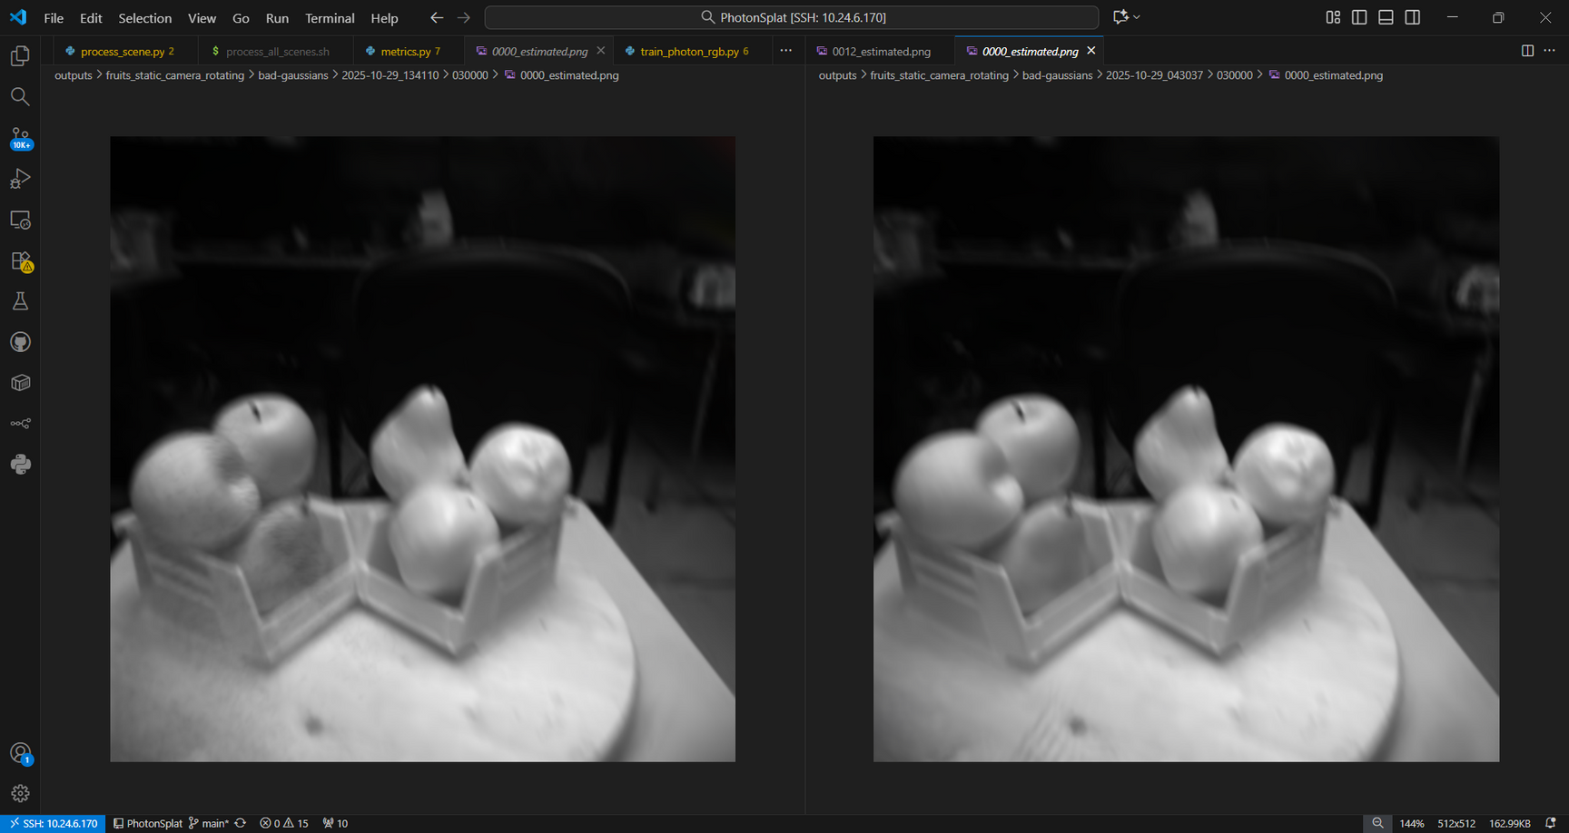
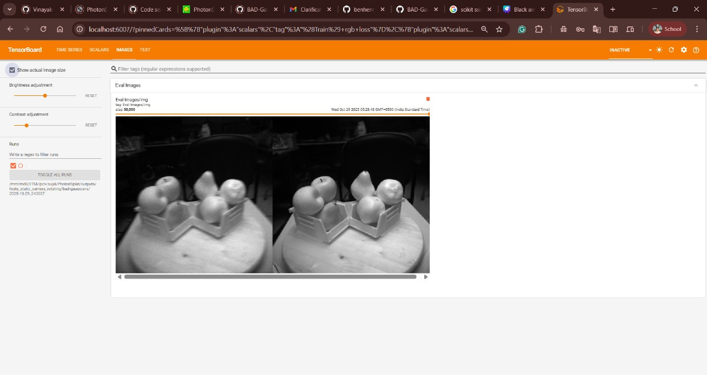
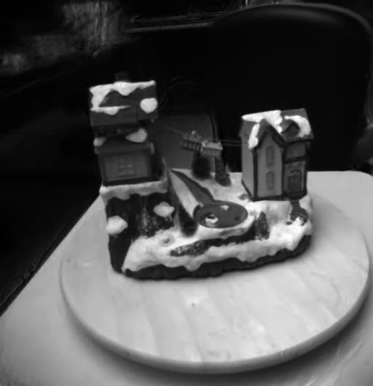
Results:
Task 2
Linear interpolation
Cubic interpolation
Validation input vs output
Snow House

Slide 8
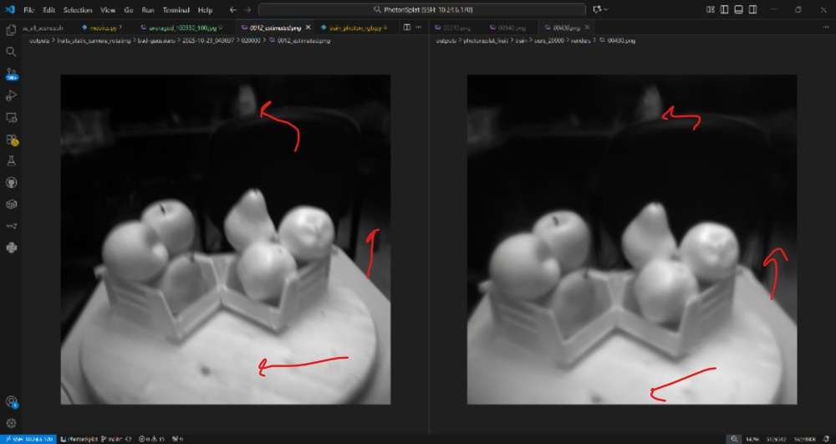
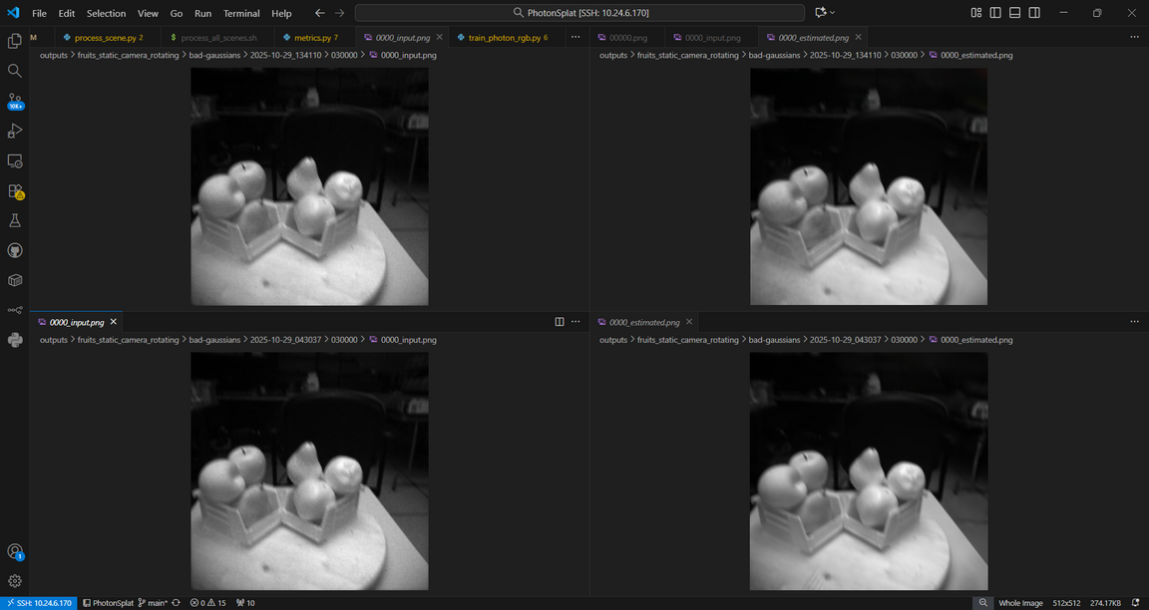
Comparison
Cubic interpolation is able to capture the nuances of camera motion trajectory better than the linear interpolation, leading to better reconstructions.
Quality vs Computation tradeoff
input.png: The actual motion-blurred input image for this frame (as captured).
estimated.png: The network’s best estimate of the sharp latent image for this frame
BAD Gaussian
PhotonSplat
Linear interpolation
As visible in this , BAD-Gaussian is able to make much more robust reconstruction for the same image. The sharpness of image is increased when using BAD-Gaussian
Cubic interpolation
Notes:
Estimated image: the sharp rendering it believes produced the blurry input via motion blur

Slide 9
Conclusion
BAD Gaussian implementation helps to achieve more robust, real-time, photon-limited 3D reconstruction by accumulating SPC frames along photon trajectory.
The obtained render by BAD Gaussian is much sharper when compared to baseline Photon-Splatting, accepting inputs that might be motion blurred.
References
Contributions
https://arxiv.org/pdf/2506.21680
https://arxiv.org/pdf/2308.04079
https://arxiv.org/pdf/2403.11831
Sujal - brainstorming, code implementation
Nikshay - brainstorming, presentation

Slide 10
Thank You !

